Slide 1
Pavement crack detection
Professor: Volker Rodehorst
Student: Khanh Ha

Slide 2
Paper collection
Collected about 26 papers regarding crack detection

Slide 3
Pick a paper for implementation
Automatic Pavement Crack Detection Based on Structured Prediction with the Convolutional Neural Network.
Why?
  the data set is available
  the main idea of the paper is understandable to me.
  Just want to pick a simple one to quickly get an understanding about the problem

Slide 4
Data set
The CFD database contains 118 RGB images with a resolution of 320 × 480 pixels
  Images are taken from iphone 5 from pavements of Beijing.
The AigleRN database contains 38 gray-level images
  Images been collected on French pavement
  Pre-processed to reduce non-uniform illumination

Slide 5
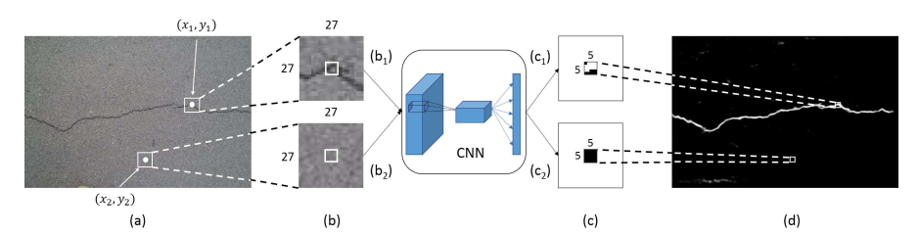
Main idea

Slide 6
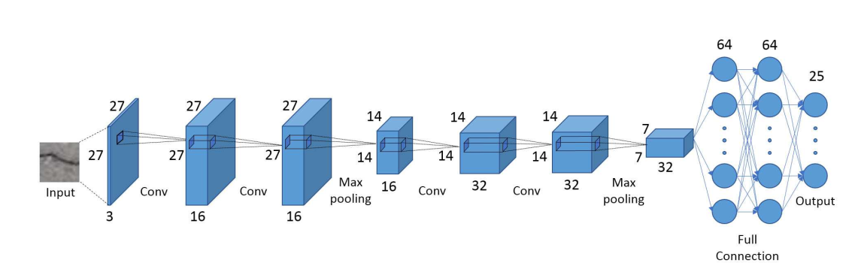
Architecture

Slide 7

Architecture
Cross entropy loss

Slide 8

Architecture
Over-fitting reduction
Dropout layer: 0.5
Batch normalization layer: added by me

Slide 9
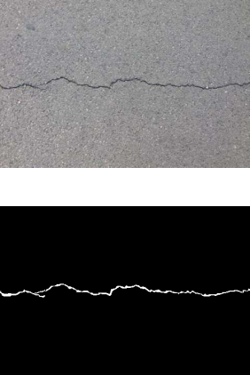
Implementation: data extraction
Positive patch extraction (crack patch)
  Skeletonize the ground true mask to shrink the crack.
    I think that doing it would help reduce redundancy
  Extract patch of [27,27] at each crack pixel.
Negative patch extraction
  Dilate the ground true mask: dilation with = 13
  Extract patch of [27,27] at each black pixel

Slide 10
Implementation: training process
Split patch list (1.3 million positive and negative patches)
  Testing: 25%
  Training: 55%
  Validation: 20%
Batch size: 256
Epochs: 50
Weight initialization: xavier method
After an epoch ends
  Shuffle the training patch list

Slide 11
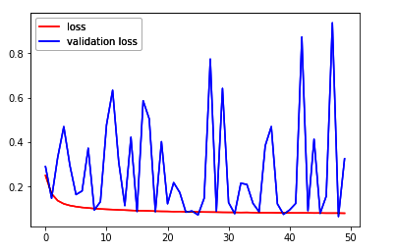
Implementation: learning curve
Why is there noise in the validation loss?

Slide 12
Implementation: accuracy
Test loss: 0.0636
Test accuracy: 97.271

Slide 13
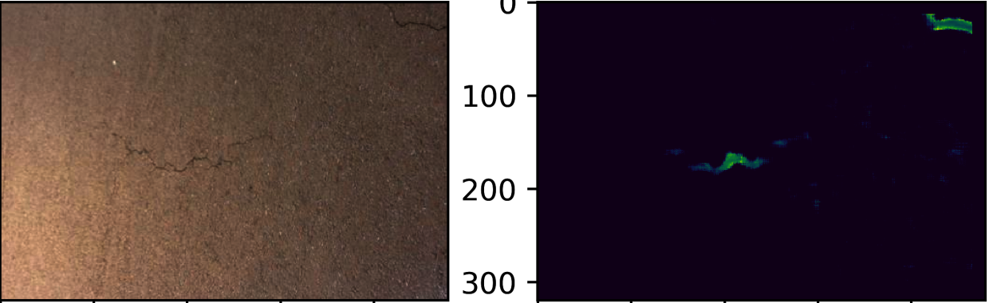
Inference result
x

Slide 14
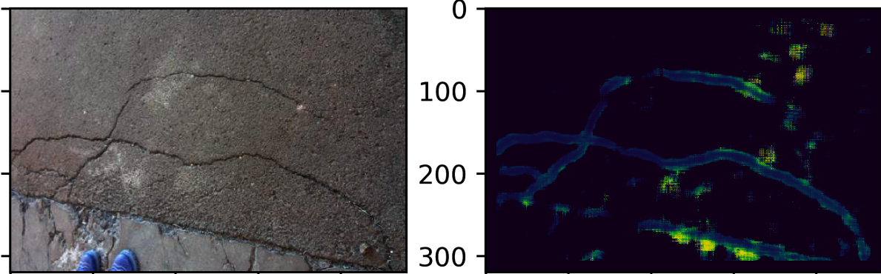
Inference result

Slide 15
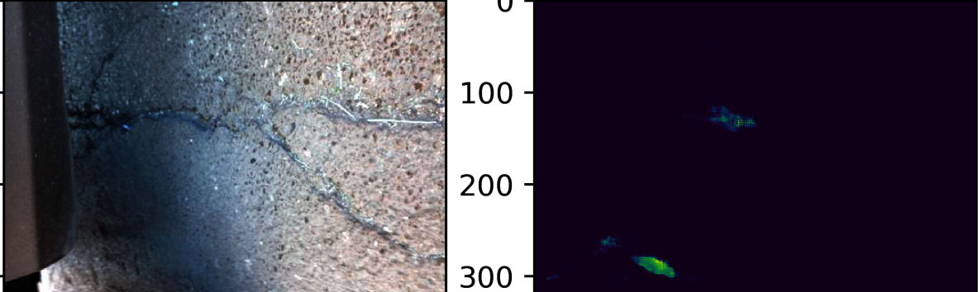
Inference result

Slide 16
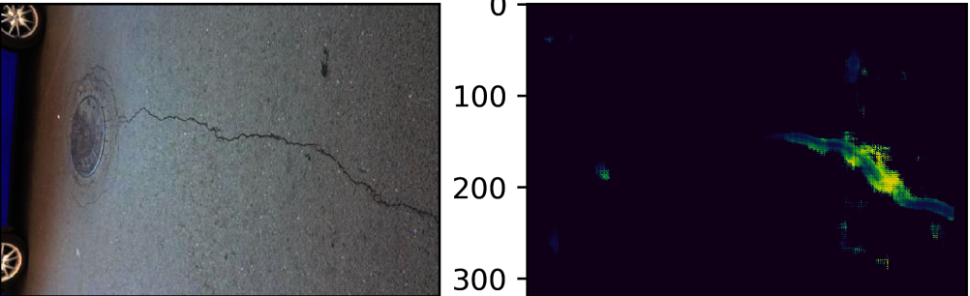
Inference result

Slide 17
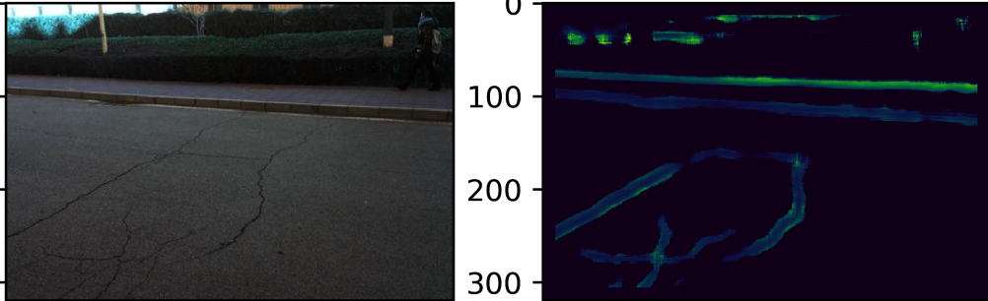
Inference result

Slide 18
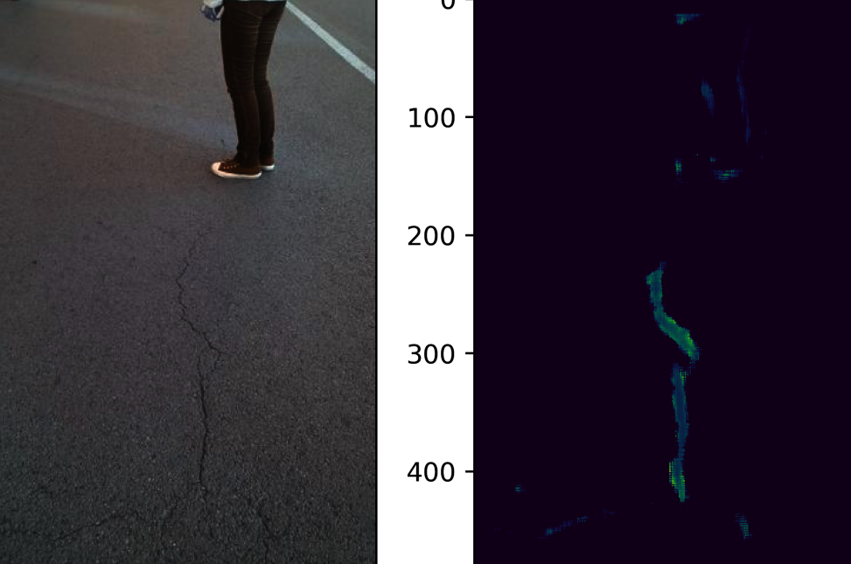
Inference result

Slide 19
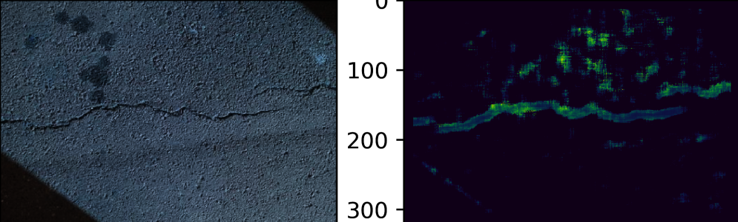
Inference result

Slide 20
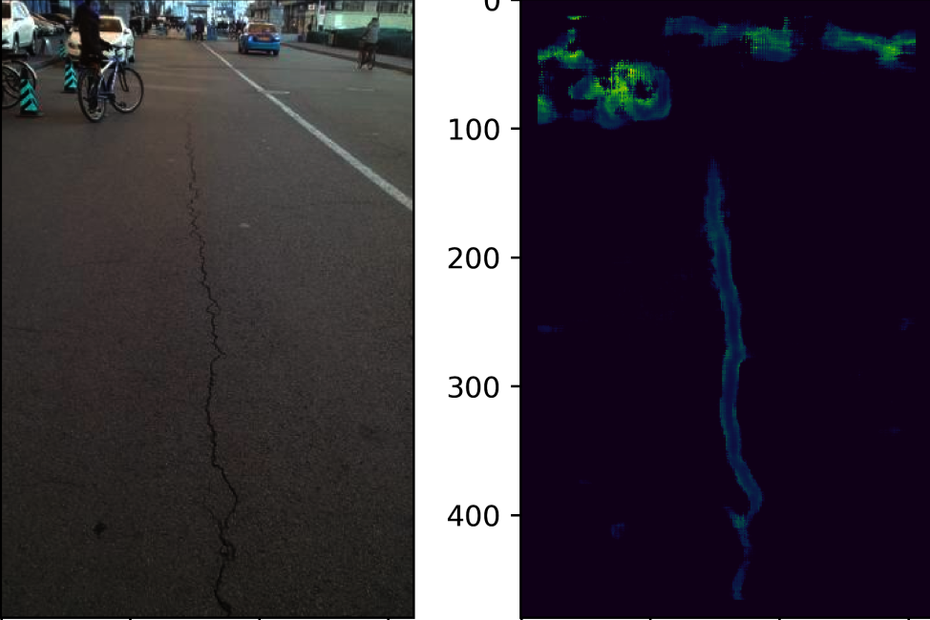
Inference result

Slide 21
observation
Is the current result better than canny edge?
  NO

Slide 22
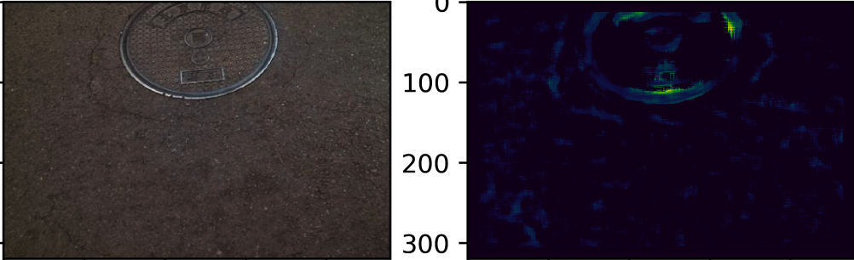
Need more global information
A patch of [27,27] is small
  doesn’t give model enough semantic information about a crack
  It recognizes this one as crack

Slide 23
Imbalanced data
The accuracy is high because of the imbalanced data
  How to check it
    Needs to find out out how calculate recall/precision/F1 score given the current result

Slide 24
what’s next?
define clear the problem of the current approach
transfer learning ?
data augmentation ?
look for ideas from other paper

Slide 25
Takeaway
Remember to normalize data at the inference step
  It took me at least several hours to figure out why the model prediction is just 0
  Convert: [0 255] => [0 1]

Slide 26

Thank for your attention!

Slide 27
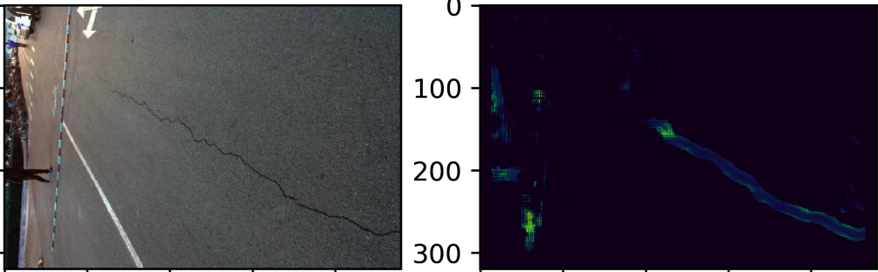
More result

Slide 28
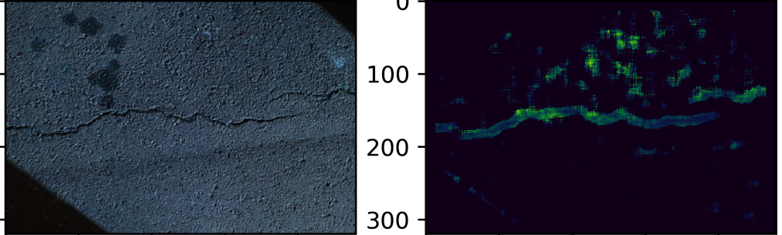

Slide 29
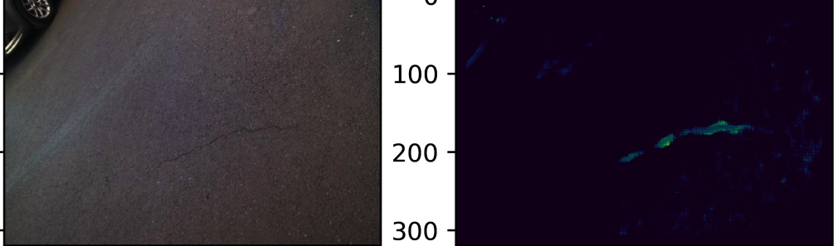

Slide 30


